Slide 1
Contribute to Learn:
Building DF/IR Expertise Through Open Source
Christopher Eng / ogmini

Slide 2
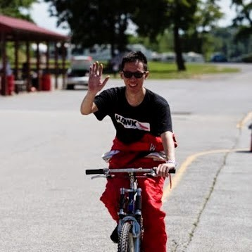
$me = Get-Item .\christopher.eng
$me.Name - Christopher Eng
$me.CreationTime - redacted
15+ years of IT experience
Independent Digital Forensic Researcher
Work and thoughts are solely my own and not that of my employer

Slide 3

Why this talk?
Where do I go from here?
How can I really learn DF/IR?

Slide 4

Why Open Source Matters
Real world tools, real world problems
Transparent
Agile
Customizable
Collaboration
Peer Review
Modifiable

Slide 5
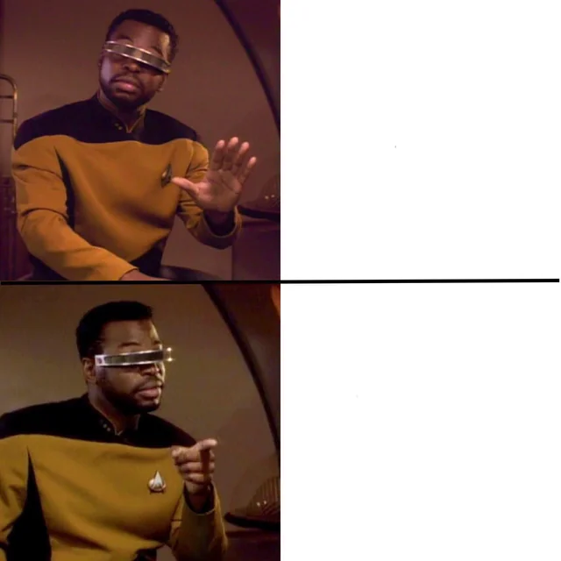
Ways to Contribute
Just using a Forensic Tool
Documentation / Discussion
Testing / Validation
Pull Requests
Contributing to a Forensic Tool

Slide 6




My A-Ha! Moments
Collaboration
KAPE Targets/Modules
Velociraptor
ALEAPP
CTF Artifacts
Notepad State Library

Slide 7
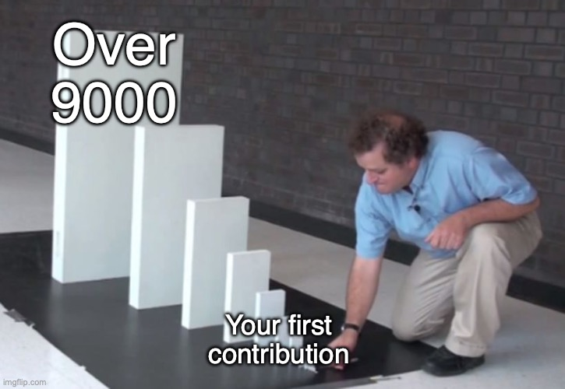
Getting Started/Tips
Don’t need to be a developer
Update/write documentation
Participate in discussions
Help test/validate changes

Slide 8
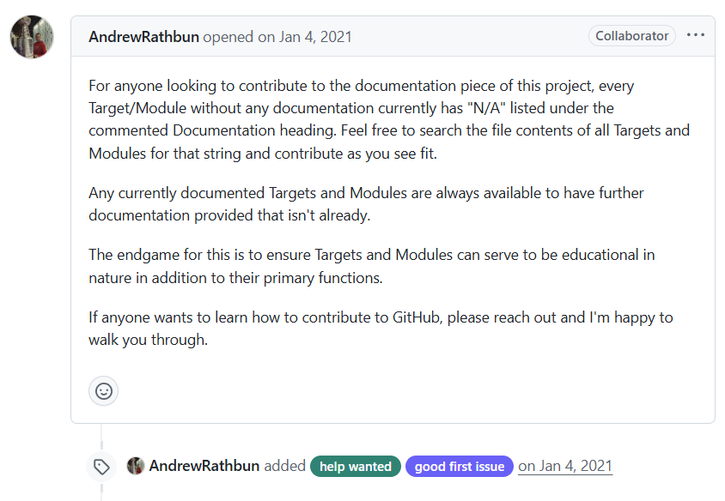
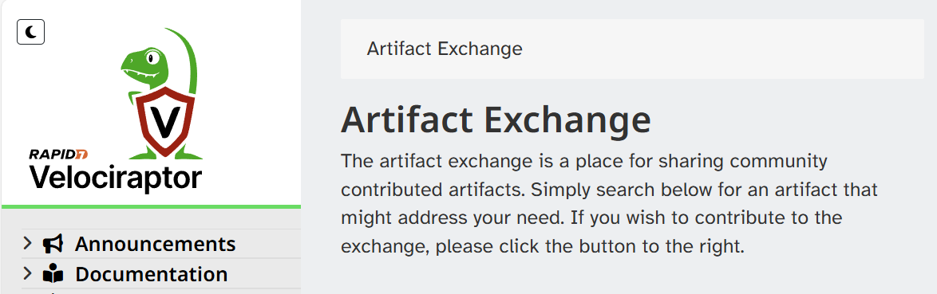

Call to Action
https://github.com/EricZimmerman/KapeFiles
https://docs.velociraptor.app/exchange/

Slide 9
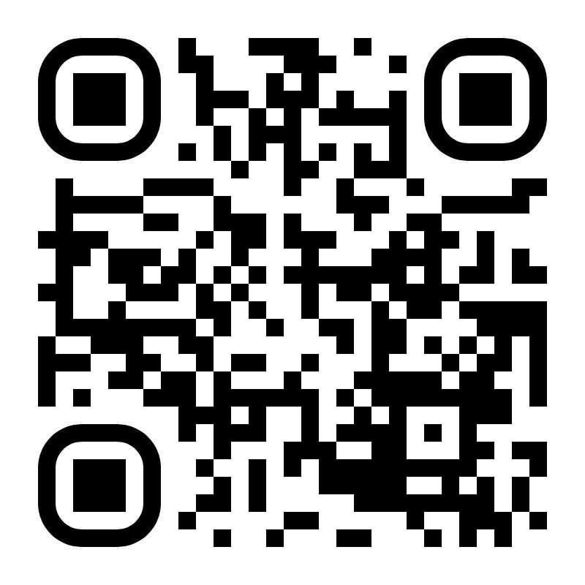
Conclusion
Slidedeck and information available at:
https://ogmini.github.io/talks
Work and thoughts are solely my own and not that of my employer

